Slide 1
Learning Objective
To learn more about the SAT and to review what to bring on
Test Day.
Agenda:
1. Announcements
2. SAT Reminders
3. Checklist

Slide 2
This Week’s Announcements

Slide 3
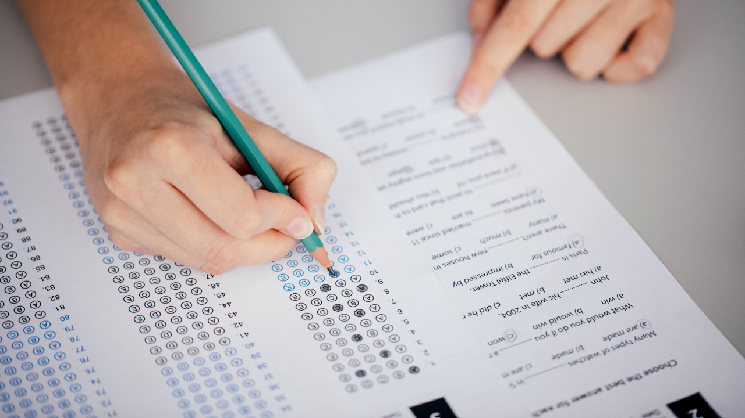
SAT Basics
You can sign up for the SAT on https://www.collegeboard.org/
If you receive free or reduced lunch, you are eligible for a SAT Fee Waiver. Mr. Longoria can give you this. The fee waiver allows you to take two SATs for free for both your Junior and Senior years. Otherwise, the test is $52.
What score do I need? There is no one answer to this question. It depends on which universities you are applying to and what majors. See Mr. Gordon for more info.

Slide 4
SAT Basics
You can list four free colleges to send your scores to at the time of registration or until nine days after taking the test. This is the fastest way, but you will not find out your scores before they are sent to the college.
If you wait until after the nine days, it is $12 per college to have your scores sent.
You will find out your score about 3 weeks after your test day.

Slide 5
What to Bring to your
SAT Test Day
Your Admission Ticket (ask Mr. Gordon if you need this printed off)
A non-expired government or school issued ID
Two No. 2 pencils with erasers
An approved calculator (you can borrow a calculator from Mrs. Eide, Dr. Sutcliffe, or Mr. Ford if you do not have one). They do not provide calculators at the testing site.
A non- smartwatch (without an audible alarm)
Drink and snacks (for your break)
It is important that you get a good night’s sleep and eat a large breakfast before taking the test. This will help you focus on the test, instead of being hungry or tired.

